Slide 1
Chapter 6
Unsupervised Deep Learning for Secure Internet of Things

Slide 2

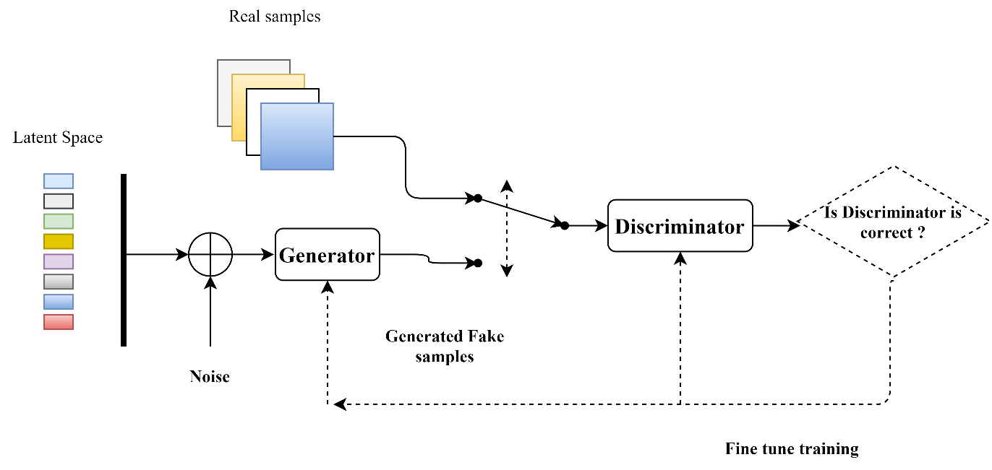
Generative Adversarial Networks

Slide 3
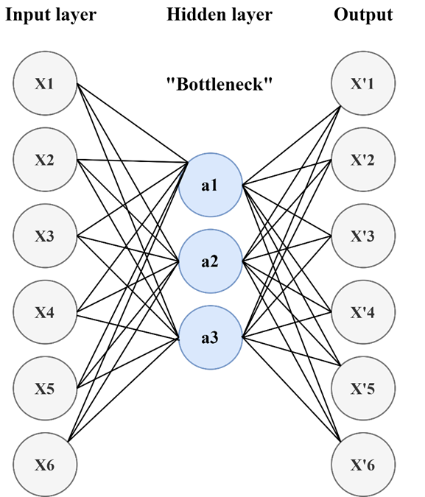
Autoencoders

Slide 4
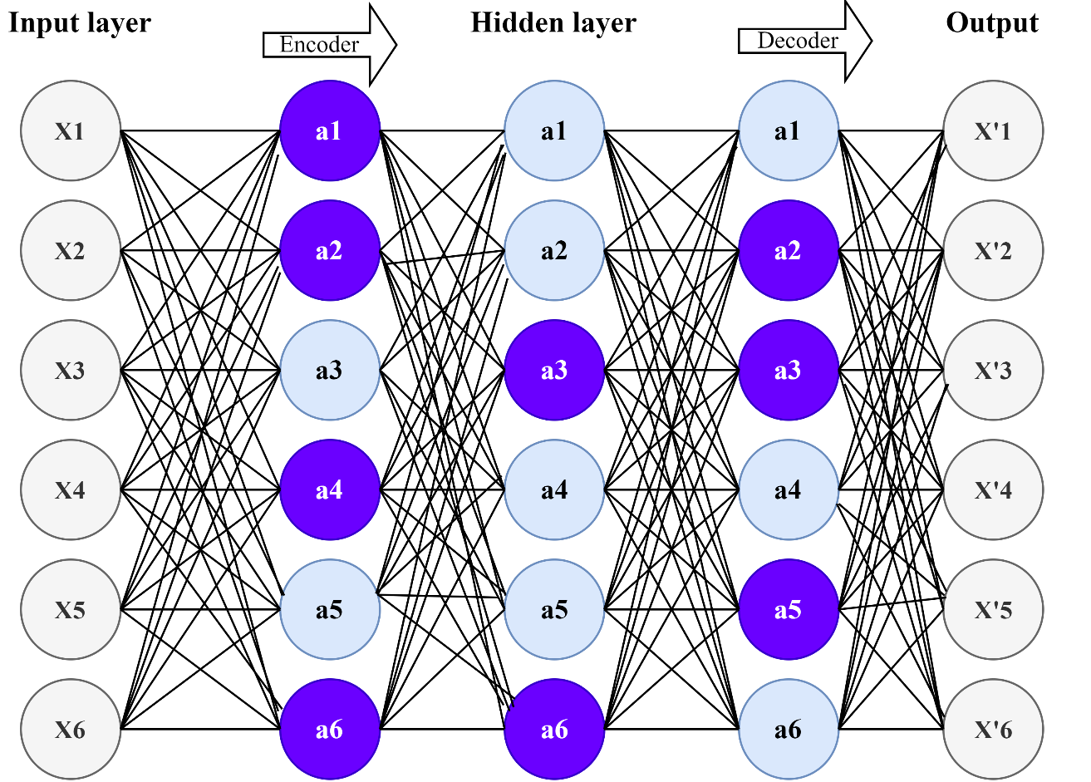
Autoencoders

Slide 5
Autoencoders

Slide 6
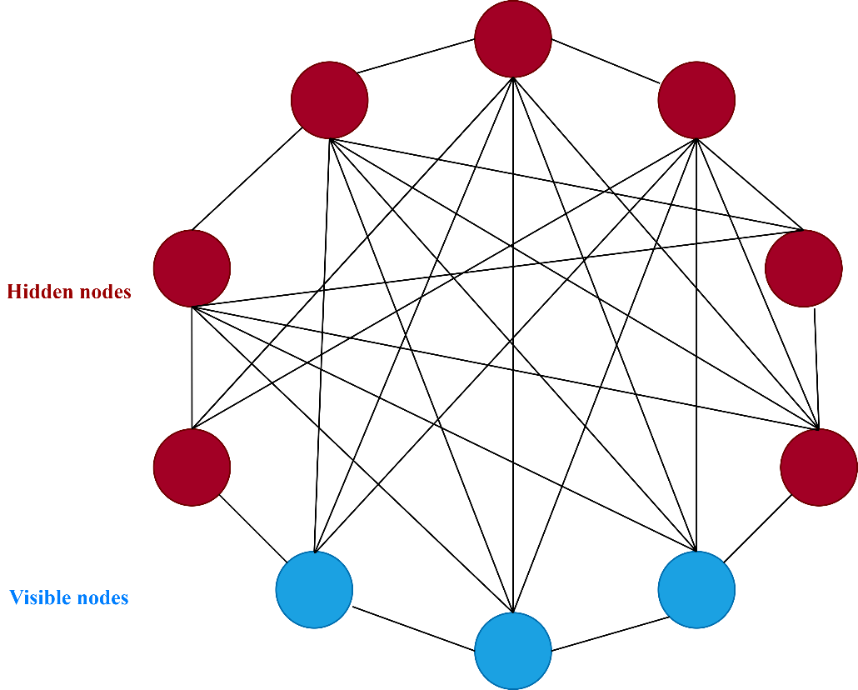
Energy-based Models

Slide 7
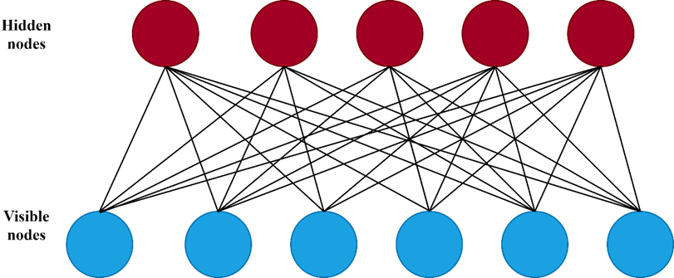
Energy-based Models

Slide 8
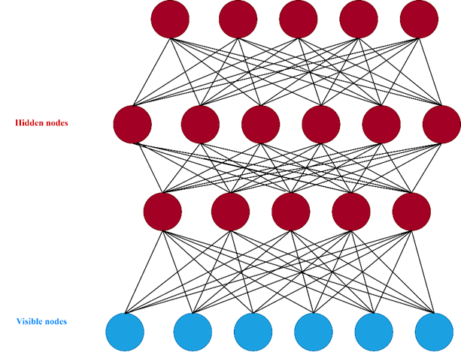
Energy-based Models

Slide 9
Energy-based Models

